Slide 1
ETL Fundamentals
Introduction to ETL Concepts

Slide 2
Objectives
Through this chapter you will be able
to understand:
What is ETL?
ETL Architecture?
What are ETL Transformations?
What are ETL Standards?
How is ETL related to Metadata?
What is fact and dimension?
What is SCD?

Slide 3


ETL Fundamentals
ETL is the most time-consuming process in DW development.
80% of development time is spent on ETL!

Slide 4


ETL Fundamentals
Let me explain what is ETL?
Extract
Transform
Load
The process of writing data into database
The process of converting data from one form to another
The process of reading data from database

Slide 5
ETL Fundamentals
What is a ETL?
ETL stands for extraction, transformation and loading. These processes are required for transferring the operational data to data warehouse or presentation area.
Extraction: It is a process which involves reading and understanding the source data. It also involves copying the source data which can be put into the staging area for further manipulation.
Transformation: During the ETL process, a number of processes occur under transformation:
1) Cleansing data – Correcting spelling, checking missing data, checking & resolving the domain conflicts.
2) Combination of data from multiple sources.
3) Deduplication of data.
4) Assignment of warehouse keys.

Slide 6
ETL Overview
Loading:
The integrated data is loaded into the presentation area of data warehouse. Before loading the transformed data, if the data is normalized, it is termed as enterprise data warehouse.
Data staging area also involves sorting and sequential processing of data. It may consist of flat files. It consumes lots of time and is more costly. It is better to improve the presentation area than taking time in normalizing the data before loading to the presentation area.
Loading is basically the process of loading the data in the data warehouse to each of the data marts. Indexing should be there in the data mart before arrival of data for better query performance. Thus the loaded data is indexed and supplied for publishing.

Slide 7
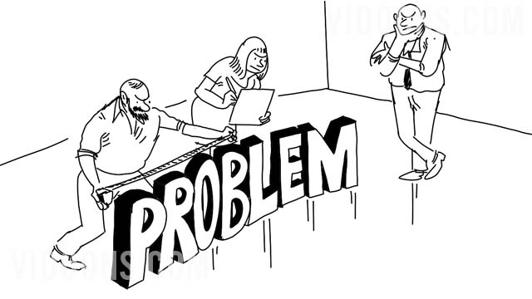

ETL & DW
So where ETL fit in Datawarehouse
Lets look at the next slide

Slide 8
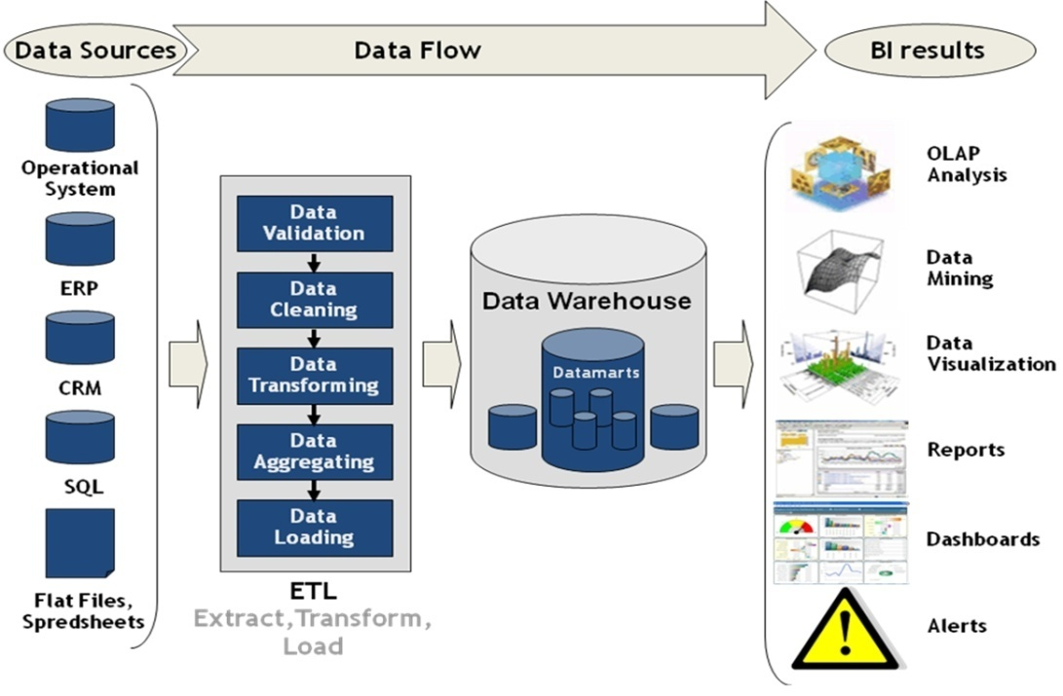
ETL Architecture

Slide 9


ETL Architecture
ETL Architecture
ETL architecture connects three areas: source, staging, and target. Sources are typically one or more OLTP systems. Staging is a common holding and work area. Targets are typically a data warehouse or mart.

Slide 10
Transformations in ETL
How can we transform data?
What are different ways to do it?
Yeah !! Good Question||
What is Transformation and where to use that?
A transformation operation accesses input data, applies one or more operators and functions on it and produces output data

Slide 11
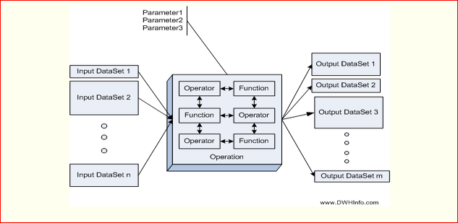
Transformations in ETL
Operations could change the value of the data, change its format, change its order, change the structure by adding new data or removing data from it.
We can also provide parameters to the Operations to customize the way they operate.

Slide 12
Transformations in ETL
Aggregation
The data aggregation operation is used to calculate values on one input field by reading all the rows together and grouping the rows with respect to one or more input fields (called the grouping fields) in the input dataset
Lookup
The Lookup operation takes attribute values from the input data set and checks whether it is present in another dataset. If the value is present in both the input dataset and the referred dataset, then the lookup operation returns the matched value along with the remaining attribute values from the referenced dataset, else it returns NULL.
The dataset from which we take the attribute values is called the input dataset, the dataset where we check if the values from the input dataset is present is called the referred dataset or the reference dataset. The attribute for which the value is checked is called the lookup attribute. The lookup attribute must be the same on the on both input and reference datasets
Data Sort
The data Sort Operations takes the rows from one input dataset, sorts them based on one or more attribute to produce a dataset containing rows sorted on the attributes.
Filter
The data Filter Operation takes all the row values from the input dataset, tests the value of a field in the row for one a condition, if the condition is false for the attribute value of the row, then we ignore the row else we pass the row into to the result dataset.
Sort
The data Sort Operations takes the rows from one input dataset, sorts them based on one or more attribute to produce a dataset containing rows sorted on the attributes.

Slide 13
ETL OR ELT?
ETL - EXTRACT TRANSFORM LOAD
Much more flexible
ELT – EXTRACT LOAD TRANSFORM
Get data is database and then transform
Less flexible
Requires staging
Difficult to modify output formats
Better performance as all data processed in same database
No need to download from database for Transform step
Should we go for ETL or ELT????
Yes. ETL is better than ELT

Slide 14

ETL and Metadata
What is Metadata?
Universal definition of Metadata is "Data about Data"
The metadata in a data warehouse system unfolds the definitions, meaning, origin and rules of the data used in a Data Warehouse.
When you deal with a data warehouse, various phases like Business Process Modeling, Data Modeling, ETL, Reporting etc., are inter-related with each other and they do contain their own metadata. For example in ETL, it will be very difficult for one to extract, transform and load source data into a data warehouse, if there is no metadata available for the source like where and how to get the source data.

Slide 15


ETL and Metadata
What is a MetaData ?
Metadata summarizes basic information about data, which can make finding and working with particular instances of data easier
What data can you see here?
What metadata can you see here?
The second row, containing information like John Hick, 36, $3000, Informatica Specialist are known as Data
The first row, (i.e) table header containing headings like Employee Name, Employee Age, Employee Salary, Employee Title are called as Metadata for the above said data.

Slide 16
ETL and Metadata
In ETL, Metadata Repository is where all the metadata information about source, target, transformations, mapping, workflows, sessions etc., are stored. From this repository, metadata can be manipulated, queried and retrieved with the help of wizards provided by metadata capturing tools. During the ETL process, when we are mapping source and target systems, we are actually mapping their metadata.
For example when you work with Informatica's Metadata Exchange, it captures the metadata present in these tools and loads into the repository. There is no need for Informatica developer to create these data structures once again since metadata(data definitions) have been already captured and stored. Similarly most of the ETL tools have that capability to capture metadata from RDBMS, files, ERP, Applications etc
In any organization, a useful metadata often stored in a repository can be a handy resource to know about the organization's information systems. Assume that each department in an organization may have a different business definitions, data types, attribute names for the same attribute or they may have a single business definition for many attributes. These anomalies can be overcome by properly maintaining metadata for these attributes in the centralized repository.
Thus metadata plays a vital role in explaining about how, why, where data can be found, retrieved, stored and used efficiently in an information management system.

Slide 17
Fact And Dimension
Let us have the detailed discussion about Fact and Dimension in the next Presentation

Slide 18

Fact And Dimension
Suppose that a sales company sells products to customers.
Help find out the fact and dimension for this scenario

Slide 19


Fact And Dimension
Every sale is a fact that happens, and the fact table is used to record these facts.
For example:
Product ID | Customer ID | Unit Sold
17 | 2 | 1
21 | 3 | 2
4 | 1 | 1
Dimension table about customers:
Customer ID | Name | Gender | Income | Education | Region
1 | Brian Edge | M | 2 | 3 | 4
2 | Fred Smith | M | 3 | 5 | 1
3 | Sally Jones | F | 1 | 7 | 3
In this example, the customer ID column in the fact table is the foreign key that joins with the dimension table.
By following the links, you can see that row 2 of the fact table records the fact that customer 3, Sally Jones, bought two items of product is 21. The company would also have a product table to determine what Sally bought.

Slide 20
Fact And Dimension
Fact
A fact table is the central table in a star schema of a data warehouse. A fact table stores quantitative information for analysis and is often denormalized.
A fact table works with dimension tables. A fact table holds the data to be analyzed, and a dimension table stores data about the ways in which the data in the fact table can be analyzed. Thus, the fact table consists of two types of columns. The foreign keys column allows joins with dimension tables, and the measures columns contain the data that is being analyzed.
Dimension
In data warehousing, a dimension is a collection of reference information about a measurable event
A data warehouse organizes descriptive attributes as columns in dimension tables. For example, a customer dimension’s attributes could include first and last name, birth date, gender, etc., or a website dimension would include site name and URL attributes.
A dimension table has a primary key column that uniquely identifies each dimension record (row). The dimension table is associated with a fact table using this key. Data in the fact table can be filtered and grouped (“sliced and diced”) by various combinations of attributes.

Slide 21
Fact And Dimension
Dimensions are used in data warehouse star and snowflake schemas, OLAP cubes, and business intelligence (BI) and business analytic (BA) applications.
The following dimensions can be used to meet specific data warehousing needs:
junk dimensions - a collection of miscellaneous attributes that are unrelated to any particular dimension.
degenerate dimensions - data that is dimensional in nature but stored in a fact table.
role playing dimensions - a dimension that can play different roles in a fact table depending on the context.
conformed dimensions - a dimension that has exactly the same meaning and content when being referred to from different fact tables.

Slide 22
Slowly Changing Dimension
Slowly Changing Dimensions (SCD) - dimensions that change slowly over time, rather than changing on regular schedule, time-base. In Data Warehouse there is a need to trackchanges in dimension attributes in order to report historical data. In other words, implementing one of the SCD types should enable users assigning proper dimension's attribute value for given date
Type I Change (overwrite/update no history)
Type II Change (new record – add a dimension row)
Type III Change (new attribute – add a dimension column)

Slide 23
Slowly Changing Dimension
Type I Change
Overwriting the old value. In this method no history of dimension changes is kept in the database. The old dimension value is simply overwritten be the new one. This type is easy to maintain and is often use for data which changes are caused by processing corrections(e.g. removal special characters, correcting spelling errors).
Before the change
Customer_ID | Customer_Name | Customer_Type
1 | Cust_1 | Corporate
After the change
Customer_ID | Customer_Name | Customer_Type
1 | Cust_1 | Retail

Slide 24
Slowly Changing Dimension
Advantages
Fast & Easy to implement
Attribute value always reflect the latest assignment
No history of prior attribute values
In DW environment, can we afford to do that?
NO!!!
Disadvantages
History of attribute changes is lost
If there is any increase in sale of the product, the management would not know the reason
Aggregates over department have to be rebuilt
Data is SCD 1 is overwritten and history is lost

Slide 25

Slowly Changing Dimension
Type II Change
Creating a new additional record. In this methodology all history of dimension changes is kept in the database. You capture attribute change by adding a new row with a new surrogate key to the dimension table. Both the prior and new rows contain as attributes the natural key(or other durable identifier). Also 'effective date' and 'current indicator' columns are used in this method. There could be only one record with current indicator set to 'Y'. For 'effective date' columns, i.e. start_date and end_date, the end date for current record usually is set to value 9999-12-31. Introducing changes to the dimensional model in type 2 could be very expensive database operation so it is not recommended to use it in dimensions where a new attribute could be added in the future.

Slide 26
Slowly Changing Dimension
Before the change:
Customer_ID | Customer_ Name | Customer_ Type | Start_Date | End_Date | Current_Flag
1 | Cust_1 | Corporate | 22-07-2010 | 31-12-9999 | Y
After the change:
Customer_ID | Customer_ Name | Customer_ Type | Start_Date | End_Date | Current_Flag
1 | Cust_1 | Corporate | 22-07-2010 | 17-05-2012 | N
2 | Cust_1 | Retail | 18-05-2012 | 31-12-9999 | Y

Slide 27
Slowly Changing Dimension
Type II Change: Advantages
Automatically partitions history in the fact table
Customer profile is easily differentiated
Tracks as many dimension changes as required
No need to rebuild aggregates
Type II Change: Disadvantages
Dimension table can become big
Does not allow association of the new attribute value with old fact history & vice-versa
SCD Type II a new record is created and history can be see through dates.

Slide 28
Slowly Changing Dimension
Type III Change:
Add a dimension column
Alternate Reality
Both current & prior values can be regarded as true at the same time
New and historical fact data can be seen either with the new or prior attribute values
Not used very often
Adding a new column. In this type usually only the current and previous value of dimension is kept in the database. The new value is loaded into 'current/new' column and the old one into 'old/previous' column. Generally speaking the history is limited to the number of column created for storing historical data. This is the least commonly needed technique.

Slide 29
Slowly Changing Dimension
Before the change:
Customer_ID | Customer_Name | Current_Type
1 | Cust_1 | Corporate
After the change:
Customer_ID | Customer_Name | Current_Type | Previous_Type
1 | Cust_1 | Retail | Corporate

Slide 30
Slowly Changing Dimension
Type III Change: Problems
Good for handling predictable changes
Can lead to lot of wastage of space
Myriad of unpredictable changes
Cannot track the impact of numerous intermediate attribute values
SCD Type III has the limitation of overwriting intermediate values and only one previous value can be tracked

Slide 31


Slowly Changing Dimension
Which SCD type is commonly used in ETL???
TYPE I if history is not important
Depending on the requirement and logic we choose SCD
TYPE II if all historical data is required
TYPE III if only immediate history data is required

